Slide 1
Lessons Learned From Agile Quality Assurance In Scrum

Slide 2

Cross-cutting Infrastructure
User Interface
Business Logic
Data Access
Service Gateways
Data Source
External Services

Slide 3
GUI Unit Test
Cross-cutting Infrastructure
User Interface
Fake Business Logic
Business Logic
Data Access
Service Gateways

Slide 4
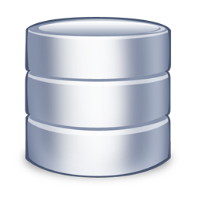
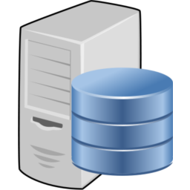

Source Repository
Build Server
Development Machine

